Slide 1
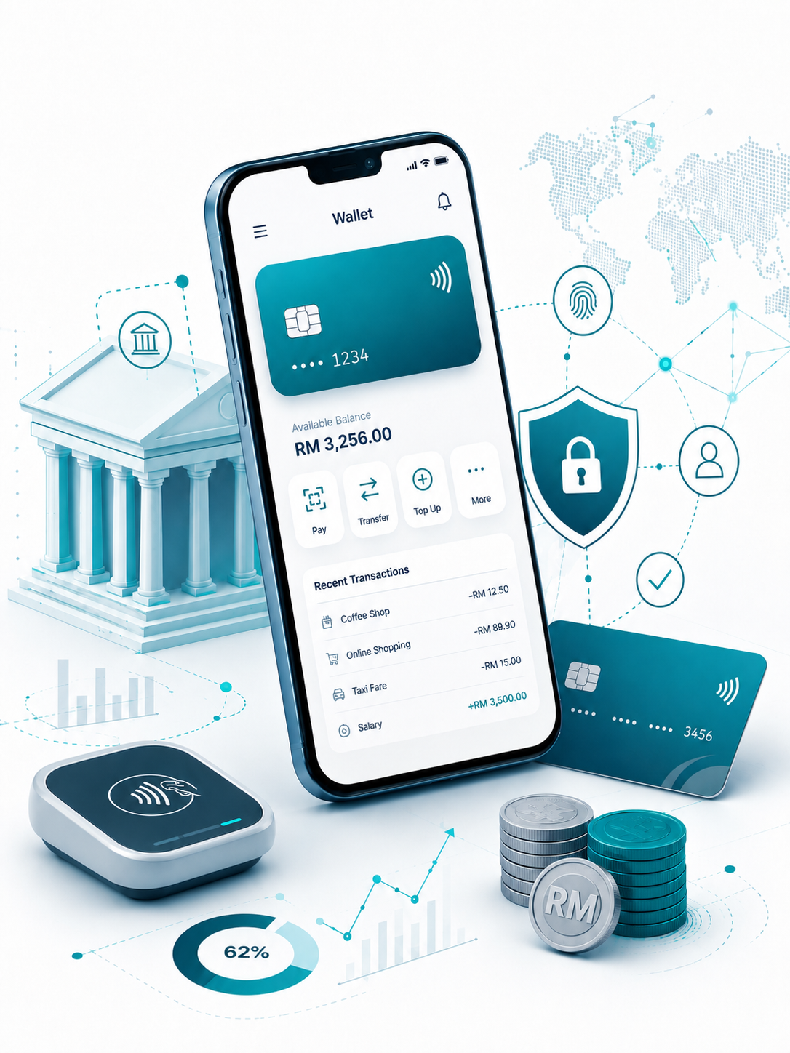

Insert relevant picture related to the topic
TFB3323 FINTECH INNOVATION
WEEK IX
DIGITAL-ONLY BANKS
Shuhaida Bt M Shuhidan
(Dr (FSMC/UTP))
BACHELOR OF XXXXXX
DEPARTMENT OF COMPUTING
FACULTY OF SCIENCE, MANAGEMENT & COMPUTING
© 2026 INSTITUTE OF TECHNOLOGY PETRONAS SDN BHD
All rights reserved. No part of this document may be reproduced, stored in a retrieval system or transmitted in any form or by any means (electronic, mechanical, photocopying, recording or otherwise) without the permission of the copyright owner.

Slide 2
RECAP FROM PREVIOUS LECTURE
Big Tech’s Edge: Tech giants leverage massive, pre-existing user bases and strong brand trust to enter financial services. Their primary goal is to increase customer loyalty rather than chase direct financial revenue.
Diverse Tech Strategies: Google and Meta provide payment features to capture data for highly targeted advertisements. Amazon utilizes merchant financing and accounts to boost its core retail sales , while Apple integrates tools like digital wallets and credit features to expand iPhone utility.
The Super App Template: China's Tencent and Alibaba created unified lifestyle platforms that fully bundle messaging, payments, lending, and wealth management. This ecosystem model serves as a global template for how tech firms can rapidly scale retail finance.
Traditional Bank Strengths: Incumbent institutions retain critical advantages over tech entry, including deep reservoirs of day-to-day transactional customer data. They also benefit from relationship-building physical branch networks and significantly higher consumer trust for safeguarding data privacy.
Strategic Partnerships: Traditional banks and independent FinTech startups stand to lose the most market ground to major online giants. This shared threat is actively encouraging legacy banks and smaller FinTechs to build tighter collaborative alliances.
Notes:
Learning Outcomes Slide
Note:
Include 2–4 lecture-level learning outcomes
Use measurable action verbs
Map explicitly to Course Learning Outcomes (CLOs)

Slide 3
LEARNING OUTCOMES
By the end of this session, students will be able to:
Define digital and cryptocurrencies: Differentiate between digital currencies and cryptocurrencies like Bitcoin.
Explain Bitcoin mechanics: Understand how cryptography solves the double-spending problem and how digital wallets function.
Describe cryptocurrency mining: Explain how mining validates transactions, creates new blocks, and controls the coin supply.
Assess Bitcoin as a currency: Evaluate its weaknesses as a medium of exchange, unit of account, and store of value.
Analyze benefits and risks: Weigh the advantages (e.g., lower fees, reduced fraud) against the risks (e.g., volatility, criminal use, economic destabilization).
Notes:
Learning Outcomes Slide
Note:
Include 2–4 lecture-level learning outcomes
Use measurable action verbs
Map explicitly to Course Learning Outcomes (CLOs)

Slide 4
TOPICS
Blockchain & Crypto-Currencies Overview?
1.1. Definitions of Digital Currencies and Cryptocurrencies
1.2. The Nature of Cryptocurrency
1.3. Features of a Successful Cryptocurrency
2. Bitcoin Mechanics?
2.1. Solving the Double Spending Problem
2.2. Buying and Storing Bitcoins (Digital Wallets)
2.3. Receiving and Sending Bitcoins
Bitcoin Mining
3.1. The Mining Process and Proof of Work
3.2. Bitcoin Supply Limits
3.3. Tasks of Miners
Blockchain Forks
4.1. Soft Forks vs. Hard Forks
4.2. Bitcoin Cash Ecosystem
Notes:
Engagement and Activity Slides
Note:
Include at least one engagement element where appropriate:
Think–Pair–Share
Mini task
Poll or reflection question
Suggested duration: 3–5 minutes
Activities shall align with learning outcomes

Slide 5
TOPICS
Bitcoin: Weaknesses as a Currency
5.1. Challenges as a Medium of Exchange
5.2. Challenges as a Unit of Account
5.3. Challenges as a Store of Value
CryptoCurrencies: Benefits & Risks
6.1. Key Benefits (e.g., Reduced Fraud, Cross-Border Transfers, Freedom of Payments)
6.2. Major Risks (e.g., Volatility, Criminal Activities, Economic Risks)
6.3. Future Challenges (e.g., Scalability, Block Size, Regulatory Attitudes)
Conclusion
7.1. Macroeconomic Impacts of "Cryptoization"
7.2. Environmental, Tax, and Market Concentration Concerns
Notes:
Engagement and Activity Slides
Note:
Include at least one engagement element where appropriate:
Think–Pair–Share
Mini task
Poll or reflection question
Suggested duration: 3–5 minutes
Activities shall align with learning outcomes

Slide 6

BLOCKCHAIN & CRYPTO-CURRENCIES
Digital
Currencies

Slide 7
Financial Technology – Blockchain & Crypto-Currencies
1.1. Digital Currencies
There are many definitions of digital currency, but we shall adhere closely to the criteria used by most regulators.
Broadly, digital currency
is a digital representation of value;
functions as a currency, with the three requirements of being a medium of exchange, unit of account, and store of value accordingly;
is currently not legal tender in any jurisdiction → neither issued nor regulated or monitored by any public authority like a central bank, or private institution like banks or electronic money institutions (EMI)
Notes:
Engagement and Activity Slides
Note:
Include at least one engagement element where appropriate:
Think–Pair–Share
Mini task
Poll or reflection question
Suggested duration: 3–5 minutes
Activities shall align with learning outcomes

Slide 8
Financial Technology – Blockchain & Crypto-Currencies
1.1. CryptoCurrencies
Bitcoin is one of the most well-known digital currencies today. To be specific, Bitcoin is a cryptocurrency, which is a subset of what is generally known as a digital currency.
Bitcoin is not a fiat currency issued by a central government or an authorised agent of the government. There is no backing as legal tender by any physical commodity. However, like the fiat currency, the value of bitcoin is derived from the relationship between supply and demand.
Notes:
Engagement and Activity Slides
Note:
Include at least one engagement element where appropriate:
Think–Pair–Share
Mini task
Poll or reflection question
Suggested duration: 3–5 minutes
Activities shall align with learning outcomes

Slide 9
CryptoCurrencies
Cryptography is key to Bitcoin — Bitcoin uses public and private keys to authenticate transactions, and the proof-of-work system used to verify transactions and maintain the block chain depends on cyptography.
While Bitcoin is the first major cryptocurrency, Bitcoin alternatives, called altcoins, have mushroomed in recent years. These altcoins are essentially derivatives of Bitcoin, their developers having taken advantage of the open- source nature of Bitcoin as a base fromwhich to code
Notes:
Engagement and Activity Slides
Note:
Include at least one engagement element where appropriate:
Think–Pair–Share
Mini task
Poll or reflection question
Suggested duration: 3–5 minutes
Activities shall align with learning outcomes

Slide 10
Financial Technology – Blockchain & Crypto-Currencies
1.1. The Nature of CryptoCurrency
Cryptocurrency in its purest form is a peer-to-peer version of electronic cash. It allows online payments to be sent directly from one party to another without going through a financial institution.
The network time-stamps transactions -using cryptographic proof of work. The proof-of-work Bitcoin protocol is basically a contest for decoding and an incentive to reward those who participate. For Bitcoin, first participant to crack the code will be rewarded with the newly created coins. This contest will form a record of the transactions that cannot be changed without redoing the proof of work.
Notes:
Engagement and Activity Slides
Note:
Include at least one engagement element where appropriate:
Think–Pair–Share
Mini task
Poll or reflection question
Suggested duration: 3–5 minutes
Activities shall align with learning outcomes

Slide 11
The Nature of CryptoCurrency
Cryptocurrency is a subset of digital currency. Examples of the many digital currencies are air miles issued by airlines, game tokens for computer games and online casinos, Brixton Pound to be spent only in the Brixton local community in the Greater London area, and many other forms that can be exchanged for virtual and physical objects in a closed system and, in the case of an open system, exchanged for fiat currency.
The solutions so far adopted span from a strict ban (China and India) to recognition as a financial good (Germany) or a commodity (Finland) or an activity requiring specific authorization (USA). El Salvador is first country to use Bitcoin as legal tender (in Sept 2021).
Notes:
Engagement and Activity Slides
Note:
Include at least one engagement element where appropriate:
Think–Pair–Share
Mini task
Poll or reflection question
Suggested duration: 3–5 minutes
Activities shall align with learning outcomes

Slide 12
Financial Technology – Blockchain & Crypto-Currencies
1.1. Features of a successful CryptoCurrency
The general arguments for a successful distributed cryptocurrency are as follows:
Open-source software: A core and trusted group of developers is essential to verify the code and possible changes for adoption by the network.
Decentralized: Even if it is not fully distributed, it is essential that it is not controlled by a single group of person or entity.
Peer-to-peer: While the idea is not to have intermediaries, there is a possibility of pools of subnetworks forming.
Notes:
Engagement and Activity Slides
Note:
Include at least one engagement element where appropriate:
Think–Pair–Share
Mini task
Poll or reflection question
Suggested duration: 3–5 minutes
Activities shall align with learning outcomes

Slide 13
Features of a successful CryptoCurrency
Global: The currency is global and this is a very positive point and workable for financial integration with or without smart contracts among the parties.
Fast: The speed of transaction can be faster and confirmation time can be shortened.
Reliability: The advantage is that there is no settlement risk and it is non repudiable. The savings in cost of a large settlement team for financial activities can be potentially huge.
Secure: Privacy architecture can be better designed incorporating proof of identity with encryption. If that is done, the issues surrounding Know Your Customer/Client (KYC) and anti-money laundering and terrorist financing (AML/TF)will be resolved.
Notes:
Engagement and Activity Slides
Note:
Include at least one engagement element where appropriate:
Think–Pair–Share
Mini task
Poll or reflection question
Suggested duration: 3–5 minutes
Activities shall align with learning outcomes

Slide 14
Features of a successful CryptoCurrency
Sophisticated and flexible: The system will be able to cater to and support all types of assets, financial instruments, and markets.
Automated: Algorithm execution for payments and contracts can be easily incorporated.
Scalable: The system can be used by millions of users.
Platform for integration: It can be designed to integrate digital finance and digital law with an ecosystem to support smart contracts with financial transactions. Customized agreements can be between multiple parties, containing user-defined scripted clauses, hooks, and variables.
Notes:
Engagement and Activity Slides
Note:
Include at least one engagement element where appropriate:
Think–Pair–Share
Mini task
Poll or reflection question
Suggested duration: 3–5 minutes
Activities shall align with learning outcomes

Slide 15
CRYPTO-CURRENCIES
Bitcoin & Double
Spending
Problem

Slide 16
Financial Technology – Blockchain & Crypto-Currencies
1.1. Bitcoin & Double Spending Problem
Bitcoin is revolutionary because the double-spending problem can be solved without needing a third party. In computer science, the double-spending problem refers to the problem that digital money could be easily spent more than once. Consider the situation where digital money is merely a computer file, just like a digital document.
Alice could send $10 to Bob by sending a money file to him and can easily do so by e-mail. However, remember that sending a file actually sends a copy of the file and does not delete the original file from the computer. When Alice attaches a money file in an e-mail to Bob, she still retains a copy of the money file even after she has sent and therefore spent it.
Notes:
Engagement and Activity Slides
Note:
Include at least one engagement element where appropriate:
Think–Pair–Share
Mini task
Poll or reflection question
Suggested duration: 3–5 minutes
Activities shall align with learning outcomes

Slide 17
Bitcoin & Double Spending Problem
Bitcoin extensively uses public-key cryptography to solve the double-spending problem. In public-key cryptography, each transaction has a digital signature and contains a hash that allows for easy tamper detection,
Notes:
Engagement and Activity Slides
Note:
Include at least one engagement element where appropriate:
Think–Pair–Share
Mini task
Poll or reflection question
Suggested duration: 3–5 minutes
Activities shall align with learning outcomes

Slide 18
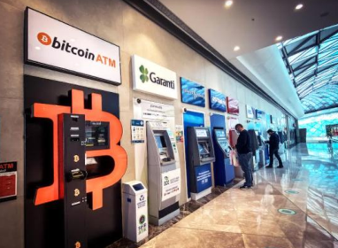
Financial Technology – Blockchain & Crypto-Currencies
1.1. Buying and Storing Bitcoins
Typically, a user who wishes to spend bitcoins obtains it by exchanging real-world currency for bitcoins. This can be achieved by purchasing bitcoins from a vending machine, from an exchange, or simply from another person.
Bitcoin vending machines, often called “ATMs,” are the most convenient way to buy bitcoins, because one can easily insert cash into a machine to obtain bitcoins instantly (Ulm, 2014).
Notes:
Engagement and Activity Slides
Note:
Include at least one engagement element where appropriate:
Think–Pair–Share
Mini task
Poll or reflection question
Suggested duration: 3–5 minutes
Activities shall align with learning outcomes

Slide 19
Buying and Storing Bitcoins
Bitcoin exchanges are also a popular means to obtain bitcoins, but users often face a time delay while waiting for bank transfers to clear (Ulm, 2014). Trading real-world cash for bitcoins is also a possibility but it is inconvenient if bitcoins are needed on the spot.
Bitcoins are typically stored in a wallet, so a user needs to have a wallet available to buy and sell bitcoins. Specifically, it is the private keys that are stored in a wallet (CoinDesk, 2014). These keys are used to access the Bitcoin addresses and sign transactions and therefore must be kept securely. There are various types of Bitcoin wallets, including desktop, mobile, webs, and hardware wallets.
Notes:
Engagement and Activity Slides
Note:
Include at least one engagement element where appropriate:
Think–Pair–Share
Mini task
Poll or reflection question
Suggested duration: 3–5 minutes
Activities shall align with learning outcomes

Slide 20
Buying and Storing Bitcoins
Users who choose to install a desktop wallet on their computer can create and keep wallets on their computer. The original Bitcoin client software, known as Bitcoin Core, which is still in use today, includes the functionality of creating a bitcoin address to send and receive bitcoins and to store the corresponding private key for that address.
The most basic function of a wallet is storing the private keys for corresponding bitcoin addresses. While the user maintains control of his desktop wallet at all times, such wallets, like any other computer file, are vulnerable to theft by malicious users or software.
When transacting at a physical store, a mobile wallet is often the most convenient way to spend some bitcoins. Mobile wallets are simply an application that provides for Bitcoin wallet functionality in a mobile phone.
Notes:
Engagement and Activity Slides
Note:
Include at least one engagement element where appropriate:
Think–Pair–Share
Mini task
Poll or reflection question
Suggested duration: 3–5 minutes
Activities shall align with learning outcomes

Slide 21
Buying and Storing Bitcoins
A wallet is needed to store or transfer bitcoins. There is a private key which is stored in a wallet (CoinDesk, 2014).
The private keys are used to access the Bitcoin addresses and sign transactions and therefore must be kept securely to prevent theft.
A desktop wallet is installed on the computer. The Bitcoin client software, known as Bitcoin Core, is used to create a bitcoin address. With a bitcoin address, one can then send and receive bitcoins, and to store the corresponding private key for that address.
Notes:
Engagement and Activity Slides
Note:
Include at least one engagement element where appropriate:
Think–Pair–Share
Mini task
Poll or reflection question
Suggested duration: 3–5 minutes
Activities shall align with learning outcomes

Slide 22
Buying and Storing Bitcoins
An online wallet is accessible from anywhere through a browser with an Internet connection, regardless of the device used (CoinDesk, 2014). The online service provider and not the user stores the private keys for a user’s Bitcoin addresses in the online wallet. The risk in using an online wallet is that since there is no control over the private key, the vendor or provider can abscond with the bitcoins. Web- based or online wallets offer extra encryption and two-factor authentication for additional security.
Notes:
Engagement and Activity Slides
Note:
Include at least one engagement element where appropriate:
Think–Pair–Share
Mini task
Poll or reflection question
Suggested duration: 3–5 minutes
Activities shall align with learning outcomes

Slide 23
BLOCKCHAIN
&
CRYPTO-CURRENCIES
Receiving and
Sending Bitcoins

Slide 24
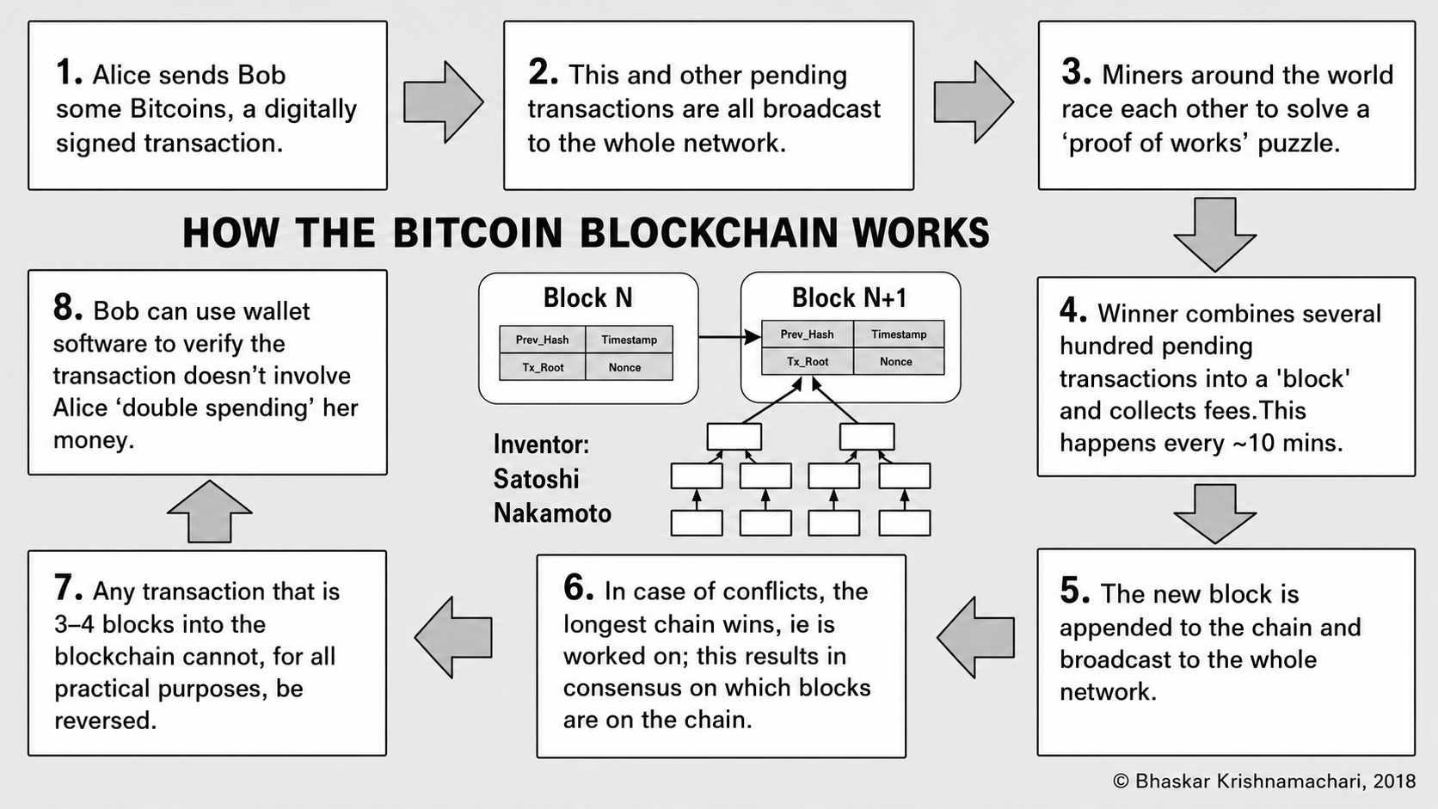
Financial Technology – Blockchain & Crypto-Currencies
1.1. Receiving and Sending Bitcoins
How the Bitcoin protocol works.
Notes:
Engagement and Activity Slides
Note:
Include at least one engagement element where appropriate:
Think–Pair–Share
Mini task
Poll or reflection question
Suggested duration: 3–5 minutes
Activities shall align with learning outcomes

Slide 25
Receiving and Sending Bitcoins
Bitcoin and other altcoins are digital cash, a way of buying and selling things over the Internet. The first step is establishing a digital wallet, either via a browser-based web wallet or by downloading a desktop or smartphone wallet from Blockchain.info, Mycelium, Coinbase, Electrum, or other Bitcoin wallet providers.
Your Bitcoin address as well as your public and private keys are generated automatically when you set up your wallet. Your Bitcoin address is typically an identifier of 26 to 34 alphanumeric characters, beginning with the number 1 or 3, that represents a possible destination for a Bitcoin payment—for example, 1JDQ5KSqUTBo5M3GUPx8vm9134eJRosLoH, represented like this string of characters or as a QR code.
Notes:
Engagement and Activity Slides
Note:
Include at least one engagement element where appropriate:
Think–Pair–Share
Mini task
Poll or reflection question
Suggested duration: 3–5 minutes
Activities shall align with learning outcomes

Slide 26
Receiving and Sending Bitcoins
Your Bitcoin address is like your email address; people with your email address can send you email; people with your public-key wallet address can send you Bitcoins.
Your wallet has your address, public and private keys, and a record of the amount of Bitcoin you control on the blockchain ledger, but not any actual cash. Your wallet should be kept as safe as any traditional wallet to protect your private keys; anyone with access to them has access to controlling or spending or transferring your Bitcoin.
Notes:
Engagement and Activity Slides
Note:
Include at least one engagement element where appropriate:
Think–Pair–Share
Mini task
Poll or reflection question
Suggested duration: 3–5 minutes
Activities shall align with learning outcomes

Slide 27
Receiving and Sending Bitcoins
With your address, anyone can send you Bitcoins (just as anyone can send you email with your email address). To send someone else Bitcoins, you need his address and the private-key part of your wallet where the software checks that you have control over the Bitcoins you would like to spend or transfer. To send someone Bitcoins, you scan his wallet address QR code or otherwise obtain his address characters or QR code (e.g., by email or SMS). The sender scans the QR code address of the receiver’s wallet and uses the wallet application to enter additional information about the transaction, such as amount, transaction fee (usually affirming the amount prespecified by the wallet software), and any other parameters to send the receiver Bitcoins.
Notes:
Engagement and Activity Slides
Note:
Include at least one engagement element where appropriate:
Think–Pair–Share
Mini task
Poll or reflection question
Suggested duration: 3–5 minutes
Activities shall align with learning outcomes

Slide 28
Receiving and Sending Bitcoins
When the sender submits the transaction, a message is broadcast from the owner of the sending address to the network that x number of coins from that address now belong to the new address. This operation is authorized by the sender’s private key; if that wallet does not have the private key corresponding to those coins, the coins cannot be spent. A bona fide transaction is received nearly immediately in the receiver’s wallet application, with an “unconfirmed” status. It then takes about 10 minutes for the transaction to confirm and be inscribed in the blockchain per blockchain miners. So, for large purchases such as a car or real estate, you would want to wait to see the transaction confirmed, but you wouldn’t bother to do so for a coffee purchase.
Notes:
Engagement and Activity Slides
Note:
Include at least one engagement element where appropriate:
Think–Pair–Share
Mini task
Poll or reflection question
Suggested duration: 3–5 minutes
Activities shall align with learning outcomes

Slide 29
Receiving and Sending Bitcoins
In Bitcoin, a private key is usually a 256-bit number (although some wallets might use between 128 and 512 bits), which can be represented in one of several ways. Here is one example of a private key in hexadecimal format (256 bits in hexadecimal is 32 bytes, or 64 characters in the range 0–9 or A–F):
Notes:
Engagement and Activity Slides
Note:
Include at least one engagement element where appropriate:
Think–Pair–Share
Mini task
Poll or reflection question
Suggested duration: 3–5 minutes
Activities shall align with learning outcomes

Slide 30
CRYPTO-CURRENCIES
Bitcoin
Mining

Slide 31
Financial Technology – Blockchain & Crypto-Currencies
1.1. Mining
New blocks of Bitcoins are created by “mining.” Mining is the process of verifying and adding transaction records to the Bitcoin public ledger [or block chain] and is done by solving a complex mathematical algorithm that creates the next block incorporating recent transactions.
Mining is costly in terms of computer processing (hardware, electricity, and time). The difficulty of the math problem becomes more complex as additional miners join the network. This controls the pace at which new Bitcoins are added to the system, and it reduces the chance that any one miner or group will take control of the block chain. The number of Bitcoins to be mined is limited to 21 million. Miners expect that the last Bitcoin will be mined in 2140 (Brito and Castillo, 2013).
Notes:
Engagement and Activity Slides
Note:
Include at least one engagement element where appropriate:
Think–Pair–Share
Mini task
Poll or reflection question
Suggested duration: 3–5 minutes
Activities shall align with learning outcomes

Slide 32
Mining
Mining is a resource-intensive process by which new blocks are added to the blockchain. Blocks contain transactions that are validated via the mining process by mining nodes and are added to the blockchain. This process is resource-intensive in order to ensure that the required resources have been spent by miners in order for a block to be accepted. New coins are minted by the miners by spending the required computing resources. This also secures the system against frauds and double spending attacks while adding more virtual currency to the bitcoin ecosystem.
Notes:
Engagement and Activity Slides
Note:
Include at least one engagement element where appropriate:
Think–Pair–Share
Mini task
Poll or reflection question
Suggested duration: 3–5 minutes
Activities shall align with learning outcomes

Slide 33
Mining
Roughly one new block is created (mined) every 10 minute. Miners are rewarded with new coins if and when they create new blocks and are paid transaction fees in return of including transactions in their blocks. New blocks are created at an approximate fixed rate. Also, the rate of creation of new bitcoins decreases by 50%, every 210,000 blocks, roughly every 4 years.
When bitcoin was initially introduced, the block reward was 50 bitcoins; then in 2012, this was reduced to 25 bitcoins. In July 2016, this was further reduced to 12.5 coins (12 coins) and the next reduction is estimated to be on July 4, 2020. This will reduce the coin reward further down to approximately six coins.
Notes:
Engagement and Activity Slides
Note:
Include at least one engagement element where appropriate:
Think–Pair–Share
Mini task
Poll or reflection question
Suggested duration: 3–5 minutes
Activities shall align with learning outcomes

Slide 34
Mining
Approximately 144 blocks, that is, 1,728 bitcoins are generated per day. The number of actual coins can vary per day; however, the number of blocks remains at 144 per day.
Bitcoin supply is also limited and in 2140, almost 21 million bitcoins will be finally created and no new bitcoins can be created after that. Bitcoin miners, however, will still be able to profit from the ecosystem by charging transaction fees.
Notes:
Engagement and Activity Slides
Note:
Include at least one engagement element where appropriate:
Think–Pair–Share
Mini task
Poll or reflection question
Suggested duration: 3–5 minutes
Activities shall align with learning outcomes

Slide 35
Mining
Bitcoin is designed with a hard limit of 21 million bitcoins, which are expected to be created by 2040 (Figure 1.3). For now, these bitcoins are generated through mining, during which miners, who are Bitcoin users running software on specialized hardware, process transactions and are rewarded with new bitcoins for contributing their computer power to maintain the network.
Mining is important not only for new bitcoins to be issued but also because it is a necessary process for transactions to be added onto the blockchain and be subsequently confirmed. The verification process is a computationally intensive process that ensures that only legitimate transactions are verified and recorded onto the blockchain.
Notes:
Engagement and Activity Slides
Note:
Include at least one engagement element where appropriate:
Think–Pair–Share
Mini task
Poll or reflection question
Suggested duration: 3–5 minutes
Activities shall align with learning outcomes

Slide 36
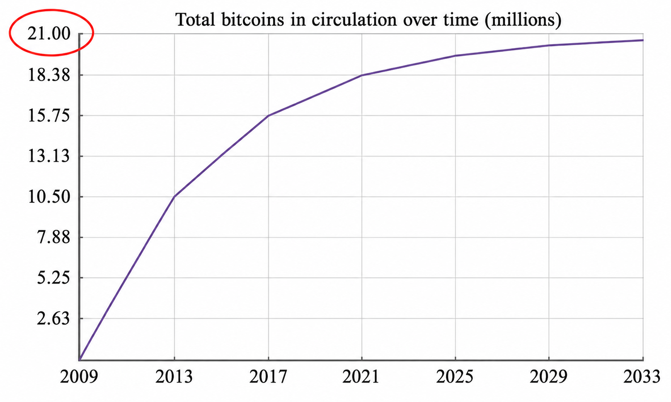
Financial Technology – Blockchain & Crypto-Currencies
1.1. Bitcoin Supply
Notes:
Engagement and Activity Slides
Note:
Include at least one engagement element where appropriate:
Think–Pair–Share
Mini task
Poll or reflection question
Suggested duration: 3–5 minutes
Activities shall align with learning outcomes

Slide 37
Financial Technology – Blockchain & Crypto-Currencies
1.1. Bitcoin Mining
Mining is a computationally intensive task that requires miners to find the solution to a predetermined mathematical problem in order to create a new block. This is the mathematical proof of work. Mining is difficult because besides ensuring that the transactions are valid, miners have to fit the data in a particular manner in order to add it to the blockchain.
Miners have to guess and search for a sequence of data that produces a required pattern. The difficulty of the problem is automatically adjusted so that a new block can only be created every 10 min on average.
Notes:
Engagement and Activity Slides
Note:
Include at least one engagement element where appropriate:
Think–Pair–Share
Mini task
Poll or reflection question
Suggested duration: 3–5 minutes
Activities shall align with learning outcomes

Slide 38
Bitcoin Mining
While bitcoin transfers are broadcast instantaneously over the network, there is, in practice, a 10 min delay for a transaction to be confirmed. This is the result of the 10 min delay for a block to be created and added onto the blockchain. Having a confirmation ensures that the network (of miners) has verified that the bitcoins are valid and have not been already spent.
Typically, most users wait for six confirmations, that is, an hour, before considering a transaction to be “confirmed,” but each user has the freedom to decide how long they wish to wait before they consider their transaction confirmed.
Notes:
Engagement and Activity Slides
Note:
Include at least one engagement element where appropriate:
Think–Pair–Share
Mini task
Poll or reflection question
Suggested duration: 3–5 minutes
Activities shall align with learning outcomes

Slide 39
Bitcoin Mining
Some concepts of Mining are being outlined here.
The hard maximum supply of bitcoin is 21 million which was set by Satoshi in the original design. Since the currency is effectively infinitely divisible as long as technology permits, then the precise amount does not matter as long as the limit remains fixed.
Bitcoin is designed with a hard limit of 21 million bitcoins, expected to be created by 2040 as shown in Figure 2.10. Until then, bitcoins are generated through mining, during which miners, who are Bitcoin users running the software on specialised hardware, process transactions and are rewarded with new bitcoins for contributing their computer power to maintain the network.
Notes:
Engagement and Activity Slides
Note:
Include at least one engagement element where appropriate:
Think–Pair–Share
Mini task
Poll or reflection question
Suggested duration: 3–5 minutes
Activities shall align with learning outcomes

Slide 40
Bitcoin Mining
Mining is important and computationally expensive. New bitcoins are mined. The miner who successfully solves the cryptography problem in the last block gets the new bitcoin. It is a necessary process for transactions to be added onto the blockchain and be confirmed approximately after six mined blocks.
Mining ensures that only legitimate transactions are verified and recorded onto the blockchain. It is the network which provides the computing power for the transactions to take place and for the transactions to be recorded.
Notes:
Engagement and Activity Slides
Note:
Include at least one engagement element where appropriate:
Think–Pair–Share
Mini task
Poll or reflection question
Suggested duration: 3–5 minutes
Activities shall align with learning outcomes

Slide 41
Bitcoin Mining
Mining is a mathematical process. The software controls the degree of difficulty of this mathematical problem. As it becomes increasingly more difficult to find the larger numbers, miners have to use special high- performance computers to find them (Tindell, 2013)
Notes:
Engagement and Activity Slides
Note:
Include at least one engagement element where appropriate:
Think–Pair–Share
Mini task
Poll or reflection question
Suggested duration: 3–5 minutes
Activities shall align with learning outcomes

Slide 42
Financial Technology – Blockchain & Crypto-Currencies
1.1. Mining – Tasks of Miners
Once a node connects with the bitcoin network, there are several tasks that a bitcoin miner performs.
Synching up with the network
Once a new node joins the bitcoin network, it downloads the blockchain by requesting historical blocks from other nodes. This is mentioned here in the context of the bitcoin miner; however, this not necessarily a task only for a miner.
Transaction validation: Transactions broadcasted on the network are validated by full nodes by verifying and validating signatures and outputs.
Notes:
Engagement and Activity Slides
Note:
Include at least one engagement element where appropriate:
Think–Pair–Share
Mini task
Poll or reflection question
Suggested duration: 3–5 minutes
Activities shall align with learning outcomes

Slide 43
Bitcoin Mining
Block validation: Miners and full nodes can start validating blocks received by them by evaluating them against certain rules. This includes the verification of each transaction in the block along with verification of the nonce value.
Create a new block: Miners propose a new block by combining transactions broadcasted on the network after validating them.
Perform Proof of Work: This task is the core of the mining process and this is where miners find a valid block by solving a computational puzzle. The block header contains a 32-bit nonce field and miners are required to repeatedly vary the nonce until the resultant hash is less than a predetermined target.
Notes:
Engagement and Activity Slides
Note:
Include at least one engagement element where appropriate:
Think–Pair–Share
Mini task
Poll or reflection question
Suggested duration: 3–5 minutes
Activities shall align with learning outcomes

Slide 44
Bitcoin Mining
Fetch reward: Once a node solves the hash puzzle, it immediately broadcasts the results, and other nodes verify it and accept the block. There is a slight chance that the newly minted block will not be accepted by other miners due to a clash with another block found at roughly the same time, but once accepted, the miner is rewarded with 12.5 bitcoins (as of 2016) and any associated transaction fees
Notes:
Engagement and Activity Slides
Note:
Include at least one engagement element where appropriate:
Think–Pair–Share
Mini task
Poll or reflection question
Suggested duration: 3–5 minutes
Activities shall align with learning outcomes

Slide 45
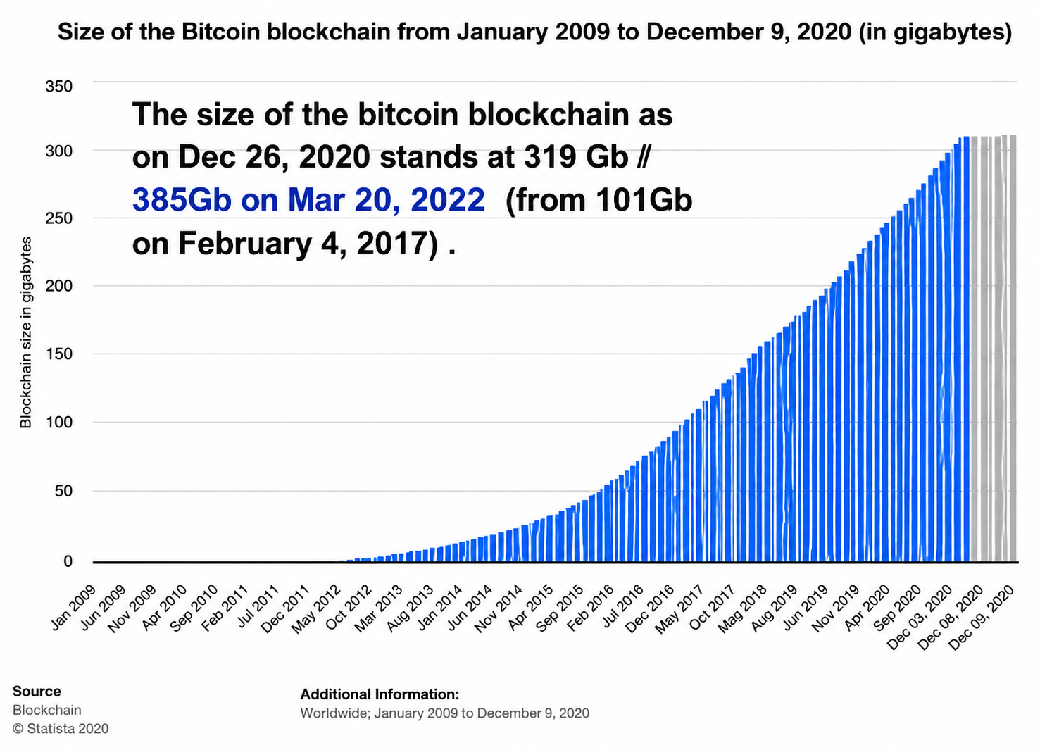
Bitcoin Mining
Notes:
Engagement and Activity Slides
Note:
Include at least one engagement element where appropriate:
Think–Pair–Share
Mini task
Poll or reflection question
Suggested duration: 3–5 minutes
Activities shall align with learning outcomes

Slide 46
CRYPTO-CURRENCIES
Hard and Soft fork
(Bitcoin Cash)

Slide 47
Financial Technology – Blockchain & Crypto-Currencies
1.1. Soft forks vs Hard forks
A soft fork is defined as a rule change that is backward compatible, i.e., old nodes would still validate blocks created under the new rules. On the other hand, a hard fork is defined as a rule change to the software that requires a compulsory upgrade on all nodes. A hard fork is not backward compatible and it is a permanent split from the legacy rules.
On the other hand, a hard fork, if not implemented correctly, results in a split. In August 2017, Bitcoin is hard forked because 15–20% of mining power rejected SegWit and resulted in the Bitcoin Cash (BCH) (BitcoinCash, 2017) mining blocks of eight megabytes in size.
Notes:
Engagement and Activity Slides
Note:
Include at least one engagement element where appropriate:
Think–Pair–Share
Mini task
Poll or reflection question
Suggested duration: 3–5 minutes
Activities shall align with learning outcomes

Slide 48
Financial Technology – Blockchain & Crypto-Currencies
1.1. Soft forks vs Hard forks
When a chain is hard-forked, data from the block immediately preceding the fork-point is replicated on the two different chains immediately after, so for cryptocurrencies, wallet entries are replicated, and users will end up with two sets of coins post-fork. This would dilute the mining power and thus a hard fork is normally undesirable.
Notes:
Engagement and Activity Slides
Note:
Include at least one engagement element where appropriate:
Think–Pair–Share
Mini task
Poll or reflection question
Suggested duration: 3–5 minutes
Activities shall align with learning outcomes

Slide 49
Financial Technology – Blockchain & Crypto-Currencies
1.1. Bitcoin Cash
Ecosystem and Bitcoin Cash
First, there is always the first-mover advantage, and Bitcoin has certainly emerged as the leading cryptocurrency and a base currency in the crypto economy. Bitcoin has a hard fork and Bitcoin Cash was created. Block 478558 was the last common block for both Bitcoin and Bitcoin Cash, and thus the first Bitcoin Cash block was 478559.
Bitcoin Cash increases the Max Blocksize Limit parameter of the Bitcoin codebase. While Bitcoin’s block size limit remains at one megabyte (allowing for 250,000 transactions per day), Bitcoin Cash has increased the block size limit to eight megabytes (allowing for around 2 million transactions per day).
Notes:
Engagement and Activity Slides
Note:
Include at least one engagement element where appropriate:
Think–Pair–Share
Mini task
Poll or reflection question
Suggested duration: 3–5 minutes
Activities shall align with learning outcomes

Slide 50
CRYPTO-CURRENCIES
Bitcoin :
Weaknesses as a
Currency

Slide 51
Bitcoin (Weaknesses as a Currency) :
1.1. Bitcoin – Weaknesses as a Currency
A successful currency typically functions as …
a medium of exchange,
a unit of account, and
a store of value
Bitcoin faces challenges in meeting all three of these criteria
Notes:
Engagement and Activity Slides
Note:
Include at least one engagement element where appropriate:
Think–Pair–Share
Mini task
Poll or reflection question
Suggested duration: 3–5 minutes
Activities shall align with learning outcomes

Slide 52
Bitcoin (Weaknesses as a Currency) :
1.1. Medium of Exchange
Because bitcoin has no intrinsic value, its worth ultimately hinges upon its usefulness as a currency in the consumer economy. Evidence of bitcoin’s footprint in daily commerce is mostly anecdotal, consisting of newspaper stories about people living only by spending bitcoin or estimates of large numbers of businesses that are willing to accept bitcoin.
To date, very few established businesses of any size have begun to take bitcoin, the most prominent being the online retailer Overstock.com. Most of the rankings of the top merchants accepting bitcoins are dominated by computer software and hardware companies selling products narrowly focused on bitcoin applications and by marketplaces or exchanges providing investor services to bitcoin speculators.
Notes:
Engagement and Activity Slides
Note:
Include at least one engagement element where appropriate:
Think–Pair–Share
Mini task
Poll or reflection question
Suggested duration: 3–5 minutes
Activities shall align with learning outcomes

Slide 53
Medium of Exchange
One obstacle to bitcoin becoming a widely used medium of exchange arises from the difficulty of procuring new bitcoins. Unless a consumer is successful as a bitcoin miner (an activity now dominated by supercomputers requiring massive capital investments), he or she must source bitcoins from online exchanges or dealers and then find a way to store them securely. These purchases typically cannot be made using a credit card or PayPal, and instead, the buyer must make a bank transfer or link an existing bank account to the exchange. The existing bitcoin exchanges often have low liquidity, significant bid-ask spreads, and a certain amount of execution and custody risk.
Notes:
Engagement and Activity Slides
Note:
Include at least one engagement element where appropriate:
Think–Pair–Share
Mini task
Poll or reflection question
Suggested duration: 3–5 minutes
Activities shall align with learning outcomes

Slide 54
Medium of Exchange
Finally, spending bitcoins requires the merchant and customer to endure a verification process that lasts, on average, 10 min. The delay is necessitated by a connection between transaction validation and mining process for new bitcoins, which is programmed to occur in 10 min cycles. Merchants have the option of trusting the customer and accepting a transaction more quickly, but this would leave them vulnerable to the customer spending the same bitcoins again before the initial transaction becomes embedded into the universal blockchain ledger.
Notes:
Engagement and Activity Slides
Note:
Include at least one engagement element where appropriate:
Think–Pair–Share
Mini task
Poll or reflection question
Suggested duration: 3–5 minutes
Activities shall align with learning outcomes

Slide 55
Bitcoin (Weaknesses as a Currency) :
1.1. Unit of Account
Bitcoin faces a number of obstacles in becoming a useful unit of account. One problem arises from its extreme volatility. Because the value of a bitcoin compared to other currencies changes greatly on a day-to-day basis, retailers that accept the currency have to recalculate prices very frequently, a practice that would be costly to the merchant and confusing to the consumer. In principle, this issue would recede in an economy that used bitcoin as its principal currency.
Notes:
Engagement and Activity Slides
Note:
Include at least one engagement element where appropriate:
Think–Pair–Share
Mini task
Poll or reflection question
Suggested duration: 3–5 minutes
Activities shall align with learning outcomes

Slide 56
Medium of Exchange
Perhaps the most serious obstacle to bitcoin becoming a widely used unit of account—and one often overlooked or trivialized by bitcoin enthusiasts—occurs due to the relatively high cost of one bitcoin compared to most ordinary products and services.
This requires merchants to quote bitcoin (BTC) prices for most goods in four or more decimal places. Although the mathematics are straightforward, for consumers, these decimal points are likely to be disconcerting. For instance, a visit to one online food retailer yields offers of a jar of salsa for 0.01694 BTC, chocolate bars for 0.00529 BTC, and a tea variety pack for 0.05255 BT
Notes:
Engagement and Activity Slides
Note:
Include at least one engagement element where appropriate:
Think–Pair–Share
Mini task
Poll or reflection question
Suggested duration: 3–5 minutes
Activities shall align with learning outcomes

Slide 57
Bitcoin (Weaknesses as a Currency) :
1.1. Store of Value
Bitcoins must be held in computer accounts known as “digital wallets,” and security for these wallets has become a major difficulty for the bitcoin industry. Some digital wallet companies have contracted with third-party insurers to provide a crude form of deposit insurance. While this strategy might work in principle, it forces the customer to bear the cost of evaluating the security (financial and otherwise) of both the wallet company and the insurance company. Digital wallet companies also offer to transfer bitcoins offline into “cold storage,” physically hiding them in remote locations using “virgin” storage devices never previously connected to a computer. These transfers entail delays in obtaining access to one’s bitcoins and, of course, additional fees.
Notes:
Engagement and Activity Slides
Note:
Include at least one engagement element where appropriate:
Think–Pair–Share
Mini task
Poll or reflection question
Suggested duration: 3–5 minutes
Activities shall align with learning outcomes

Slide 58
CRYPTO-CURRENCIES
Benefits
&
Risks

Slide 59
Bitcoin (Weaknesses as a Currency) :
1.1. Benefit : Reduce the Risk of Fraud
Fraud is one of the biggest concerns when it comes to almost anything relating to money. Whether it be transferring funds or simply using a credit card on an insecure site, the possibility of fraud is there and a big concern for everyone. This is especially true for those who’ve been the victim of fraud in the past.
Because it is not associated with your bank account or cash funds and is transferred electronically and securely with the blockchain recording all transactions, cryptocurrency will play a big part in reducing fraud which will also offer peace of mind.
Notes:
Engagement and Activity Slides
Note:
Include at least one engagement element where appropriate:
Think–Pair–Share
Mini task
Poll or reflection question
Suggested duration: 3–5 minutes
Activities shall align with learning outcomes

Slide 60
Bitcoin (Weaknesses as a Currency) :
1.1. Benefit : Increase Crowdfunding
Crowdfunding is an increasingly popular way for entrepreneurs to raise money for their concepts and/or products. Investors can make small investments instead of a few investors making large investments. Therefore, this mitigates risk. Without the risk, more investors want to get involved.
Cryptocurrency positively impacts crowdfunding. Initial coin offerings (ICOs) are centered around cryptocurrency which is used as the source of capital for a startup company’s venture.
Notes:
Engagement and Activity Slides
Note:
Include at least one engagement element where appropriate:
Think–Pair–Share
Mini task
Poll or reflection question
Suggested duration: 3–5 minutes
Activities shall align with learning outcomes

Slide 61
Bitcoin (Weaknesses as a Currency) :
1.1. Benefit : Change the Money Transfer Process
Wires and bank-to-bank transfers are faster and more efficient. However, they still have a long way to go. It can still take some transfers a week or longer to clear and be deposited – especially if the transfer is international.
The transfer of cryptocurrency doesn’t require all of the same checks and balances processes that banks do before funds can be deposited. Whether a national or international transfer, cryptocurrency transfers are instant, don’t require any fees, and can be tracked and securely stored in the blockchain.
Notes:
Engagement and Activity Slides
Note:
Include at least one engagement element where appropriate:
Think–Pair–Share
Mini task
Poll or reflection question
Suggested duration: 3–5 minutes
Activities shall align with learning outcomes

Slide 62
Bitcoin (Weaknesses as a Currency) :
1.1. Benefit : Make Cross-Border Money Transfers and Transactions Safer
In addition to reducing fraud when transferring money internationally, cryptocurrency can help make in-country transactions safer. When travelling to other countries carrying cash and money cards can be downright dangerous
Not only does the use of cryptocurrency reduce the danger of carrying cash, it also eliminates any exchange fees or transaction fees. This would keep more money in consumer and vendor pockets. Plus, it would reduce the risk of robberies.
Notes:
Engagement and Activity Slides
Note:
Include at least one engagement element where appropriate:
Think–Pair–Share
Mini task
Poll or reflection question
Suggested duration: 3–5 minutes
Activities shall align with learning outcomes

Slide 63
Bitcoin (Weaknesses as a Currency) :
1.1. Benefit : Offer a Stable Alternative to Unstable Currencies
The inflation and instability that some countries’ standard currencies have experienced is shocking. While not all countries have currencies that are subject to outrageous rates of inflation, others could seriously benefit from switching to use cryptocurrency.
Cryptocurrency is accepted worldwide and not subject to exchange and interest rates. It would also provide more stability and certainty to those living in economically volatile countries.
Notes:
Engagement and Activity Slides
Note:
Include at least one engagement element where appropriate:
Think–Pair–Share
Mini task
Poll or reflection question
Suggested duration: 3–5 minutes
Activities shall align with learning outcomes

Slide 64
Bitcoin (Weaknesses as a Currency) :
1.1. Benefit : Freedom of Payments
Bitcoin was specifically designed for fast transactions at low costs (Nakamoto, 2008). Payments can be processed with little or no fees, with the sender having the option to include a transaction fee for faster confirmations. A low transaction cost is possible because there is no single third-party intermediary. In addition to the lack of restrictions on transactions, users have full control of their bitcoins and the freedom to send and receive bitcoins anytime, anywhere, and to and from anyone.
Notes:
Engagement and Activity Slides
Note:
Include at least one engagement element where appropriate:
Think–Pair–Share
Mini task
Poll or reflection question
Suggested duration: 3–5 minutes
Activities shall align with learning outcomes

Slide 65
Benefit : Freedom of Payments
Users may also choose to use Bitcoin to make fast cross-border transfers easily without paying expensive fees for remittances. There is great potential for remittances because the value of remittances, especially from people in developed countries to those in developing countries, is expected to increase to USD515 billion in 2015 (World Bank Payment Systems Development Group, 2013). The reduced costs of remittances could be substantial if remitted using bitcoins.
Notes:
Engagement and Activity Slides
Note:
Include at least one engagement element where appropriate:
Think–Pair–Share
Mini task
Poll or reflection question
Suggested duration: 3–5 minutes
Activities shall align with learning outcomes

Slide 66
CryptoCurrencies Benefits& Risks :
1.1. Benefit : Merchant Benefits
Bitcoin presents an alternative to the other methods of electronic payments accepted by businesses. Traditional credit card acceptance is expensive for merchants, with customers often having to pay for a merchant account and various fees for transactions, including but not limited to transaction fees, interchange fees, and statement fees. These fees add up and increase the costs of accepting credit cards for payments. Yet, merchants who forgo credit card payments may lose business from customers used to the ease of paying with credit cards. Not having to pay these expensive fees may allow businesses to pass on the cost savings to consumers, benefiting everyone.
Notes:
Engagement and Activity Slides
Note:
Include at least one engagement element where appropriate:
Think–Pair–Share
Mini task
Poll or reflection question
Suggested duration: 3–5 minutes
Activities shall align with learning outcomes

Slide 67
Benefit : Merchant Benefits
Bitcoin transactions are also secure, unlike credit card payments, which may use insecure magnetic stripes and signatures, and are irreversible, unlike credit card payments, which are subject to the possibility of fraudulent charge-backs. The low cost of transactions also allows merchants to accept micropayments, paving the way for Bitcoin to be widely accepted without a minimum transaction level.
Notes:
Engagement and Activity Slides
Note:
Include at least one engagement element where appropriate:
Think–Pair–Share
Mini task
Poll or reflection question
Suggested duration: 3–5 minutes
Activities shall align with learning outcomes

Slide 68
CryptoCurrencies Benefits& Risks :
1.1. Benefit/ Risk : User Control
Each Bitcoin transaction can only be effected by the user who has the private key, putting the user in full control of his bitcoins. Merchants cannot slip in unwanted charges later, unlike credit cards that offer limited protection against such charges once an unethical merchant has the card details. Transactions also do not contain substantial personal information, which is at risk of leakage and theft.
Notes:
Engagement and Activity Slides
Note:
Include at least one engagement element where appropriate:
Think–Pair–Share
Mini task
Poll or reflection question
Suggested duration: 3–5 minutes
Activities shall align with learning outcomes

Slide 69
Benefit/ Risk : User Control
However, the converse effect of full user control is the point that the private key controls the access to one’s bitcoins. Bitcoin, being a digital currency, brings specific security challenges (Kaminsky, 2013).
Perhaps the most important risk to end users is that if the private key is lost, access to the bitcoins is irrecoverable. Poor wallet protection may leave users vulnerable to thefts, especially by specially crafted malicious software designed to steal bitcoins. Bitcoin users should therefore be security conscious with Bitcoin, just as they do for other financial activities
Notes:
Engagement and Activity Slides
Note:
Include at least one engagement element where appropriate:
Think–Pair–Share
Mini task
Poll or reflection question
Suggested duration: 3–5 minutes
Activities shall align with learning outcomes

Slide 70
CryptoCurrencies Benefits& Risks :
1.1. Benefit : Platform for Other Innovation
The Bitcoin protocol may, in its original form, work as a payment network, but it has the potential for further innovation. What actually happens in the Bitcoin network is that data in the form of Bitcoin transactions are broadcasted and verified before being kept on the blockchain. Bitcoin technology may therefore be adapted for the transfer of other types of data, like stocks or bets (Brito, 2013). Feature layers are beginning to be built on top of Bitcoin, which include smart property and assurance contracts. Being an open-source technology, alternative digital currencies like Litecoin and Dogecoin, among others, have also emerged to suit different objectives.
Notes:
Engagement and Activity Slides
Note:
Include at least one engagement element where appropriate:
Think–Pair–Share
Mini task
Poll or reflection question
Suggested duration: 3–5 minutes
Activities shall align with learning outcomes

Slide 71
CryptoCurrencies Benefits& Risks :
1.1. Challenge/ Risk : Internal Change & Volatility
As a community-driven project, Bitcoin continues to undergo changes as software developers improve and change the software with consensus of network users. At the same time, the price of bitcoins continues to fluctuate as current events affect the price. Some significant price changes are said to resemble a traditional speculative bubble, which may occur when optimistic media coverage attracts investors.
This may make it difficult to determine how good bitcoins are as a store of value, and merchants accepting bitcoins therefore often convert them out into fiat currency very quickly.
Notes:
Engagement and Activity Slides
Note:
Include at least one engagement element where appropriate:
Think–Pair–Share
Mini task
Poll or reflection question
Suggested duration: 3–5 minutes
Activities shall align with learning outcomes

Slide 72
Challenge/ Risk : Internal Change & Volatility
It is also difficult to predict the Bitcoin economy in the future as it is the first widely accessible cryptocurrency, although researchers are already working on models that will attempt to explain behavior in the Bitcoin world. At the same time, it may be possible that the value of bitcoins may become less volatile as familiarity with Bitcoin increases with time.
Discuss → As on Jan 10, 2022….Bitcoin was now down 39.2% from its $69,000 high recorded in early November 2021, while Ethereum is 36.1% short of its peak. Many lower cap coins are down 50% or more.
Notes:
Engagement and Activity Slides
Note:
Include at least one engagement element where appropriate:
Think–Pair–Share
Mini task
Poll or reflection question
Suggested duration: 3–5 minutes
Activities shall align with learning outcomes

Slide 73
CryptoCurrencies Benefits& Risks :
1.1. Risk : Facilitation of Criminal Activities
With the pseudoanonymity and ease of payments offered by Bitcoin, it is no wonder that governments are concerned with the use of Bitcoin in facilitating criminal activity.
Indeed, one of the most well-known criminal uses of Bitcoin was on the Silk Road website, a black market often used to trade illicit drugs and counterfeit passports. Silk Road used a combination of Bitcoin payments and the anonymizing network Tor to create a marketplace for such illicit goods and services .
Notes:
Engagement and Activity Slides
Note:
Include at least one engagement element where appropriate:
Think–Pair–Share
Mini task
Poll or reflection question
Suggested duration: 3–5 minutes
Activities shall align with learning outcomes

Slide 74
Risk : Facilitation of Criminal Activities
Cryptocurrencies are also used as ransom payments by Ransomwares Earlier Jun 2021, U.S. law enforcement officials said they were able to recover $2.3 million in bitcoin paid to a criminal cybergroup involved in the ransomware attack on Colonial Pipeline in May.
The FBI said its agents were able to identify a virtual currency wallet that the hackers used to collect payment from Colonial Pipeline.
Notes:
Engagement and Activity Slides
Note:
Include at least one engagement element where appropriate:
Think–Pair–Share
Mini task
Poll or reflection question
Suggested duration: 3–5 minutes
Activities shall align with learning outcomes

Slide 75
Risk : Facilitation of Criminal Activities
Another major concern regarding Bitcoin is its use to launder money and finance terrorist activity. These concerns were stoked especially after the Liberty Reserve, a private and centralized digital currency was shut down on money laundering concerns (BBC News, 2013). It is important to remember, however, that bitcoins are like money, and money can be used for both lawful and unlawful purposes. Other methods of transferring money have been used for financing crimes and money laundering even before Bitcoin existed.
However, many Bitcoin exchanges are beginning to employ antimoney laundering features that include keeping records of their customers, which will reduce the attractiveness of Bitcoin to criminals..
Notes:
Engagement and Activity Slides
Note:
Include at least one engagement element where appropriate:
Think–Pair–Share
Mini task
Poll or reflection question
Suggested duration: 3–5 minutes
Activities shall align with learning outcomes

Slide 76
CryptoCurrencies Benefits& Risks :
1.1. Risk : Economic Risks
Bitcoin is something that is very different from the existing financial system for which country regulators have experience regulating. The innovative use of Bitcoin may be disruptive to the financial and payment markets in that Bitcoin, for example, can scale up to replace money transmission and card payment services, or even stock exchanges, which renders the incumbent service providers obsolete. If these changes occur rapidly, there is a risk that this will destabilize the financial and payment markets and ultimately price stability in a market.
Notes:
Engagement and Activity Slides
Note:
Include at least one engagement element where appropriate:
Think–Pair–Share
Mini task
Poll or reflection question
Suggested duration: 3–5 minutes
Activities shall align with learning outcomes

Slide 77
CryptoCurrencies Benefits& Risks :
1.1. Risks
No consumer protection: Cryptocurrencies operate in decentralized environments, making it impossible for institutional oversight or regulation. Since crypto markets are highly unregulated, users may be exposed to more risks of scams and theft of crypto.
High Transaction Charges: Some cryptocurrency exchange platforms and wallets may charge exorbitant fees for processing transactions associated with your wallet. Also, these fees are often higher than those charged on regulated investment products.
Notes:
Engagement and Activity Slides
Note:
Include at least one engagement element where appropriate:
Think–Pair–Share
Mini task
Poll or reflection question
Suggested duration: 3–5 minutes
Activities shall align with learning outcomes

Slide 78
Risk : Facilitation of Criminal Activities
Technical Knowledge Required: Cryptocurrencies are generally a complex topic for many beginners entering the crypto market. This complexity could make it difficult for users to assess the potential risks in trades they make, especially while staking crypto.
Price Volatility: Cryptocurrency is highly volatile. Digital tokens in the market experience continuous rising and dropping in value. With such price instabilities, investors are likely to face the risk of losses.
Governments are concerned that the continued proliferation of cryptocurrencies would diminish its ability to regulate monetary policy and the monetary system, which the central bank holds to b a threat to financial stability in a country.
Notes:
Engagement and Activity Slides
Note:
Include at least one engagement element where appropriate:
Think–Pair–Share
Mini task
Poll or reflection question
Suggested duration: 3–5 minutes
Activities shall align with learning outcomes

Slide 79
CryptoCurrencies Benefits& Risks :
1.1. Economic risks
The innovative use of Bitcoin is very disruptive to the financial and payments markets. Bitcoin, for example, can scale up to replace money transmission and card payment services, or even stock exchanges. So far, the changes have been slow, But there is a risk at some point that cryptocurrency will destabilise the financial and payments markets, and ultimately price stability in a market. Few cost and benefits analyses of the crypto economy have been done partly due to the complexity of the technology and the difficulties in understanding how the technology can evolve.
Notes:
Engagement and Activity Slides
Note:
Include at least one engagement element where appropriate:
Think–Pair–Share
Mini task
Poll or reflection question
Suggested duration: 3–5 minutes
Activities shall align with learning outcomes

Slide 80
CryptoCurrencies Benefits& Risks :
1.1. Risks : Legal and regulatory attitude
The regulatory risk remains for bitcoin and cryptocurrencies as we have seen with China and Korea clamping down on the intermediaries involved in crypto-related activities such as ICOs. Governments will continue to grapple with the risks and benefits of Bitcoin to their country. However, so far, regulators have been successful in giving clarity and guidance on the treatment of digital currencies. The challenge will come when decentralisation starts to threaten the existence of centralised authority. It is a difficult task for regulators to balance innovation with risk, especially in measures relating to anti-money laundering and the countering of terrorist financing, as well as taxes.
Notes:
Engagement and Activity Slides
Note:
Include at least one engagement element where appropriate:
Think–Pair–Share
Mini task
Poll or reflection question
Suggested duration: 3–5 minutes
Activities shall align with learning outcomes

Slide 81
CryptoCurrencies Benefits& Risks :
1.1. Potential Risks
Cryptocurrency like Bitcoin depends on mining, and once the incentives for mining disappear, no one knows if the cryptocurrency in question will continue to have consensus on the digital register.
So, as they say, “let the buyer beware,” because what you own may just be worthless once there are doubts about the blockchain. It seems that if the cryptocurrency exhausts most of their coin supply too fast and too early, the probability of the coins dying is higher.
For some coins, it is difficult to know who is behind them and whether there could be a backdoor that allows someone to control the system. Cryptocurrency with unknown developers has a higher probability of being buried in the graveyard.
Notes:
Engagement and Activity Slides
Note:
Include at least one engagement element where appropriate:
Think–Pair–Share
Mini task
Poll or reflection question
Suggested duration: 3–5 minutes
Activities shall align with learning outcomes

Slide 82
CryptoCurrencies Benefits& Risks :
1.1. Challenges
As Bitcoin is not perfect, there are many challenges that the network has to overcome before the mass adoption is possible. These challenges include:
block size limit within the network;
the huge storage requirement for the blockchain;
the number of transaction per second;
privacy protection issue;
legality of smart contract and Oracle that gives the true source of external data.
Bitcoin processes 4.6 to 8 transactions per second. Visa does about 1,700 transactions per-second on average.
Notes:
Engagement and Activity Slides
Note:
Include at least one engagement element where appropriate:
Think–Pair–Share
Mini task
Poll or reflection question
Suggested duration: 3–5 minutes
Activities shall align with learning outcomes

Slide 83
CRYPTO-CURRENCIES
Conclusion

Slide 84
CryptoCurrencies Benefits& Risks :
1.1. Conclusion
Looking ahead, widespread and rapid adoption can pose significant challenges by reinforcing dollarization forces in the economy—or in this case cryptoization—where residents start using crypto assets instead of the local currency.
Cryptoization can reduce the ability of central banks to effectively implement monetary policy. It could also create financial stability risks, for example through funding and solvency risks arising from currency mismatches, as well as amplify the importance of some of the previously mentioned risks to consumer protection and financial integrity.
Notes:
Engagement and Activity Slides
Note:
Include at least one engagement element where appropriate:
Think–Pair–Share
Mini task
Poll or reflection question
Suggested duration: 3–5 minutes
Activities shall align with learning outcomes

Slide 85
Conclusion
Threats to fiscal policy could also intensify, given the potential for crypto assets to facilitate tax evasion. And seigniorage (the profits accruing from the right to issue currency) may also decline. Increased demand for crypto assets could also facilitate capital outflows that impact the foreign exchange market.
Finally, a migration of crypto “mining” activity out of China
to other emerging market and developing economies can have an important impact on domestic energy use— especially in countries that rely on more C02-intensive forms of energy, as well as those that subsidize energy costs—given the large amount of energy needed for mining activities.
Notes:
Engagement and Activity Slides
Note:
Include at least one engagement element where appropriate:
Think–Pair–Share
Mini task
Poll or reflection question
Suggested duration: 3–5 minutes
Activities shall align with learning outcomes

Slide 86
Conclusion
The experience of traditional financial exchanges also shows that investors tend to crowd into venues that offer the greatest liquidity, where traders have the best chance of buying and selling at an acceptable price.
Investor nervousness could provoke a ‘flight to security’, with investors looking to trade on the largest and seemingly most stable venues
Market data tends to confirm a movement towards concentration. By August 2022, Binance accounted for more than 50% of spot transactions on CEXs – up from 30% just five months earlier.
Notes:
Engagement and Activity Slides
Note:
Include at least one engagement element where appropriate:
Think–Pair–Share
Mini task
Poll or reflection question
Suggested duration: 3–5 minutes
Activities shall align with learning outcomes

Slide 87
SUMMARY
By the end of this session:
Cryptocurrency Basics: Decentralized digital money (like Bitcoin) relies on cryptography and peer-to-peer networks, operating without central banks or government backing.
Core Mechanics: "Mining" validates transactions and creates new coins, while digital wallets use private keys to secure funds and prevent double-spending.
Currency Flaws: Bitcoin struggles to function as everyday money due to extreme price volatility, awkward decimal pricing, and limited merchant adoption.
Main Benefits: It enables fast, low-fee, borderless payments and grants users full control over their funds without financial intermediaries.
Major Risks: The ecosystem faces severe challenges, including criminal misuse (like ransomware and money laundering), unrecoverable lost keys, scaling limits, and impending regulatory crackdowns.
Notes:
Summary and Closure Slides
Note:
Summarise 3–5 key takeaways
Reinforce main ideas
Indicate CLO coverage where appropriate
Include:
Upcoming topics
Required reading
Tutorial / lab / assessment linkage

Slide 88

THANK YOU
Shuhaida Bt M Shuhidan
DEPARTMENT OF COMPUTING
shuhaida.shuhidan@utp.edu.my
01-03-31

